Slide 1
Field Mapping Task-Splitting Algorithm
Team Machapuchare
Laxman Pokhrel
Mridul Gelal
Binisha Parajuli
Anisha Oli
Nabin Kumar Rajak

Slide 2
Problem Statement
Balance workload among teams or individuals.
Identifying and eliminating non relevant features
Optimize time utilization considering travel distances and deadlines.
Ensure scalability for projects of varying sizes.

Slide 3
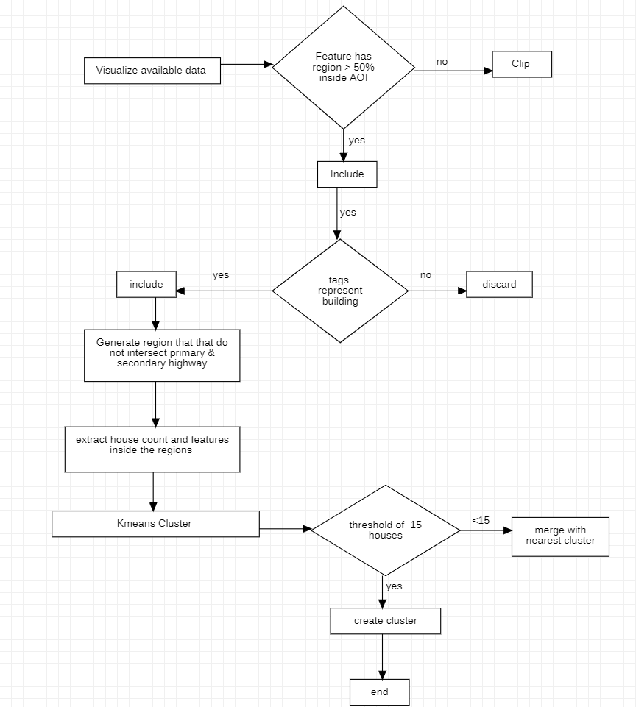
Proposed Solution

Slide 4
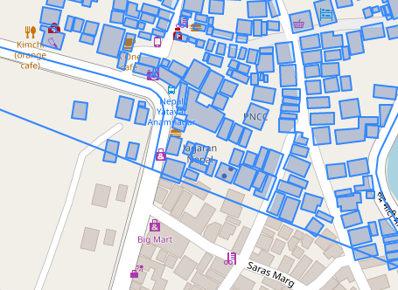
Generating features to be mapped

Slide 5
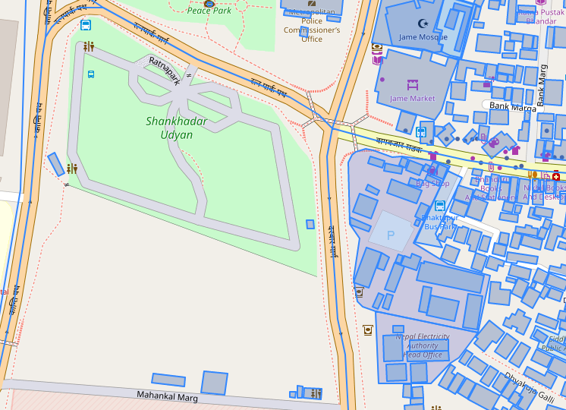
Excluding non relevant features

Slide 6
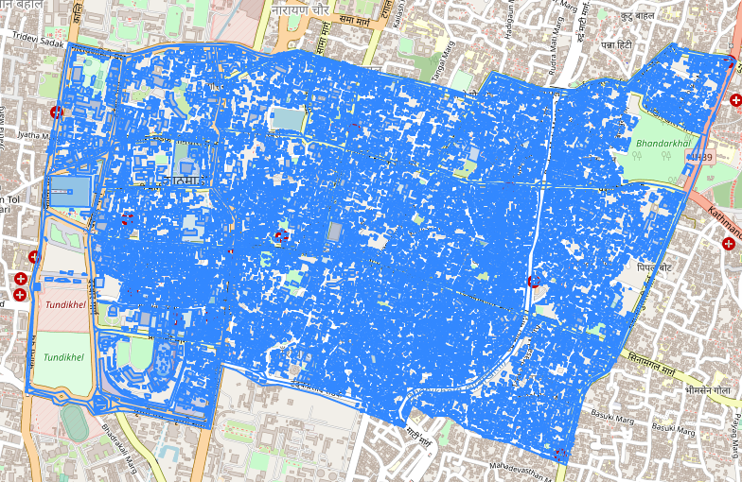
All relevant features inside area of interest

Slide 7
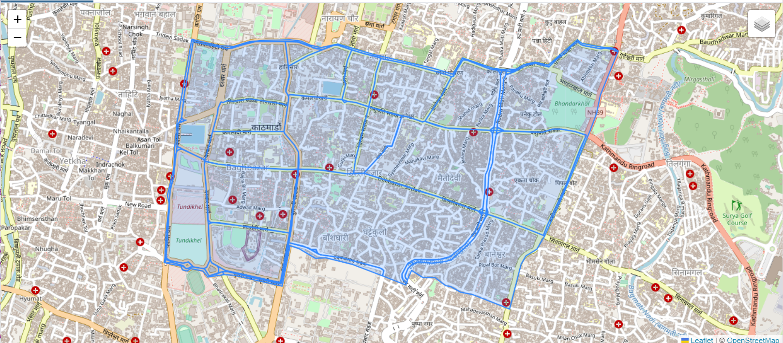
Generating regions using highways

Slide 8
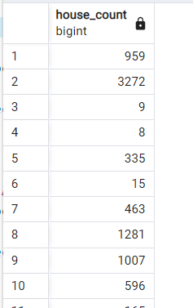
House count inside regions

Slide 9
Future Work
Utilize Manhattan distance for accurate site distance estimation.
Enhance real-time adaptability for dynamic task reassignment based on team speed.
Optimize task allocation and resource planning in challenging terrains for efficient surveying using terrain data
Integrate directional analysis during task assignment based on specific constraints (e.g., right turns only)

Slide 10
THANK YOU !

